Slide 1
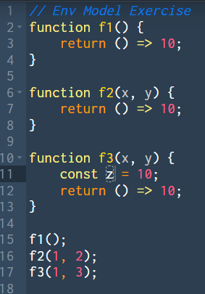

Welcome back!
Studio S10
Ma Chi Kin Brian
e1121386@u.nus.edu
Tele: @bmanara

Slide 2
We are at double digits!

Slide 3
Agenda for Today
Admin Matters
Recap
S10 Studio Worksheet
S10 In-class Studio Worksheet
RA2 Past Year Paper Questions (if time permits…)

Slide 4
Admin Matters
Reading Assessment 2 happening this Saturday, 26 October 2024
Venues: LT8 or LT11
Timing: 1:00 - 1:45 or 2:10 - 2:55
Check your venue and timing assignment properly!
Scope: Up to Week 9 Lectures, Paths, Reflections and S10 Studio (THIS STUDIO)
Note that Control & Stash is tested as well! (Not much practice on this since it was not tested in previous semesters.)
Excludes Bonus Topic Continuation-Passing Style (CPS)
Bring 2B Pencil, Soft Eraser and Student Card!
Let me know if you want a short studio consultation session on Friday. (Or just ask in telegram)
(Im free from 1200 hrs to 1600 hrs, to go through RA2 practice papers)

Slide 5
Tips for RA2
Go in with a clear mind… Get a good night’s rest the day before. (MOST IMPT)
Remember the nuances and rules for environment model, practicing helps a lot.
That’s all really… I can’t really help with control and stash as it was not tested last year :(
We asked what to expect for this topic and all we got was “No idea, just do your best.”

Slide 6
RECAP
Env Model (Revisit)
CSE Machine
Searching
Sorting
Memoization
Notes:
The next few slides from CSE are taken from the lecture directly. This is cause I honestly am not very well tuned with the CSE machine itself. Control and Stash specifically.

Slide 7
Env Model (Revisit)
Revisiting some important details of env model:
No empty frames
Only create frames when there is at least one name to be declared
No frames for evaluation of blocks if the block does not directly declare any names
Current environment is used for evaluating the body of the block
If the program itself does not directly declare any names, the global environment is the same as the program environment

Slide 8
Env Model (Revisit)
Revisiting some important details of env model:
Compound values
Arrays are drawn like pairs, but with multiple cells
Primitive values are written inside frames, and inside pairs and arrays.

Slide 9
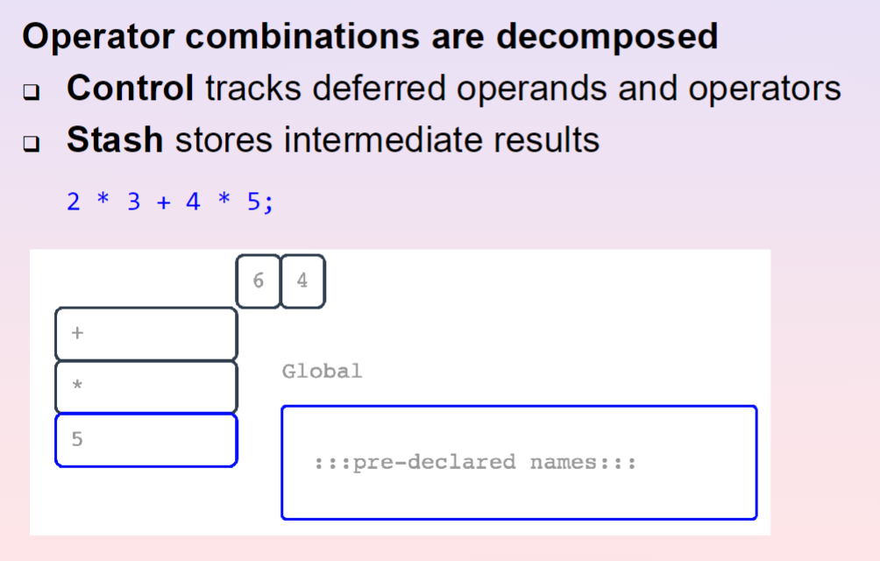
Operator Combinations

Slide 10
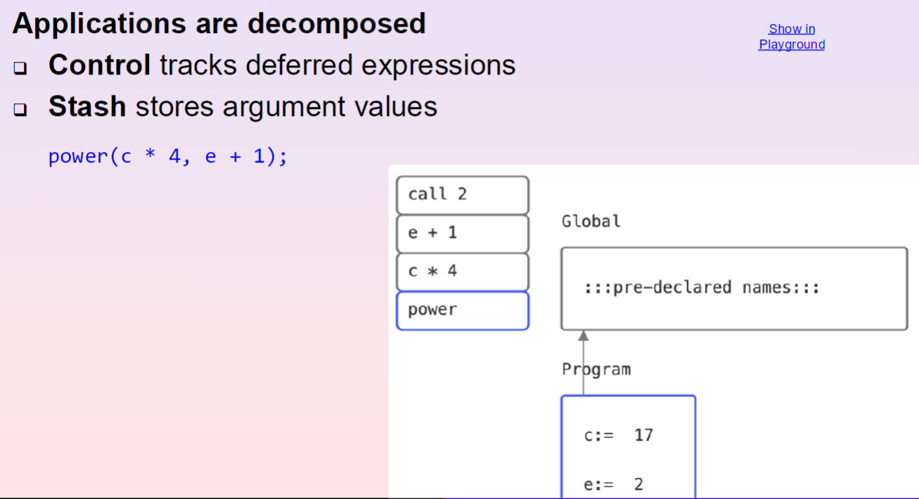
Applications
Notes:
Show on source

Slide 11
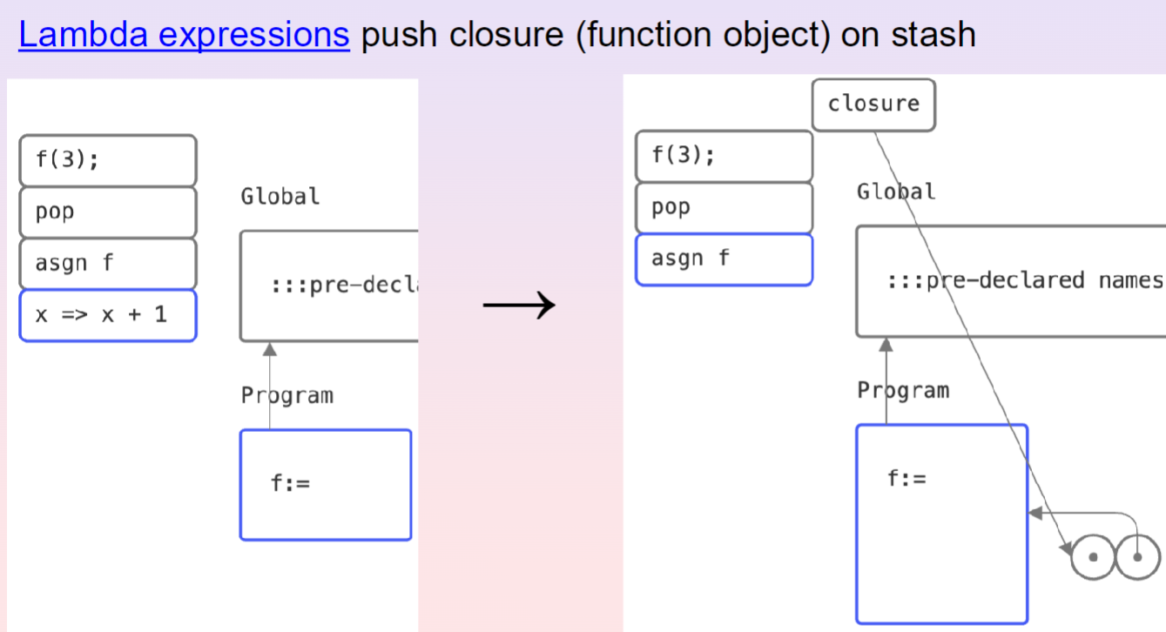
Lambda Expressions
Notes:
Show on source

Slide 12
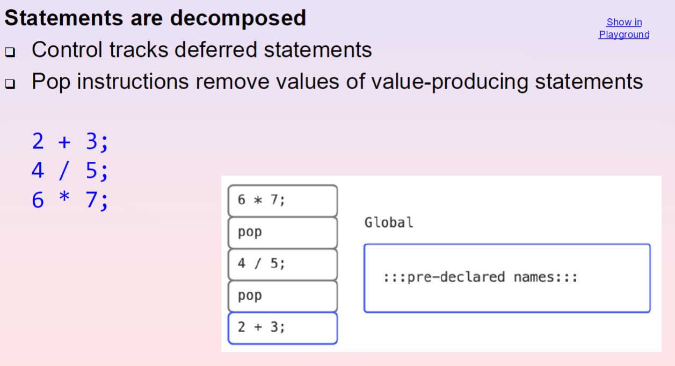
Sequences

Slide 13
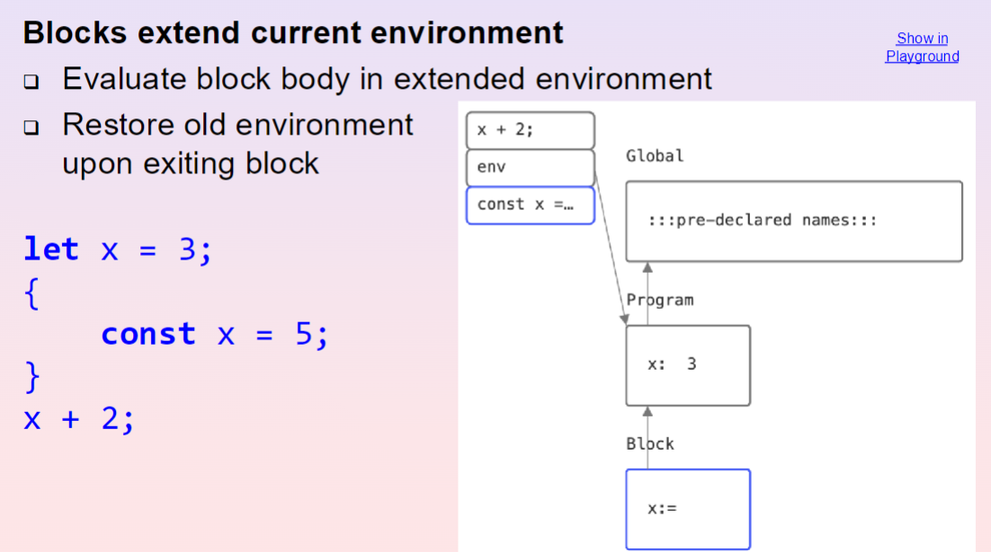
Blocks

Slide 14
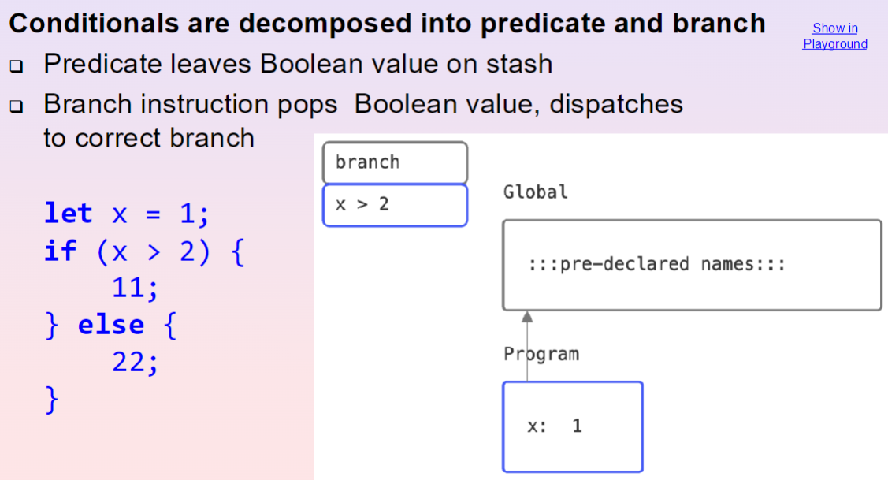
Conditionals

Slide 15
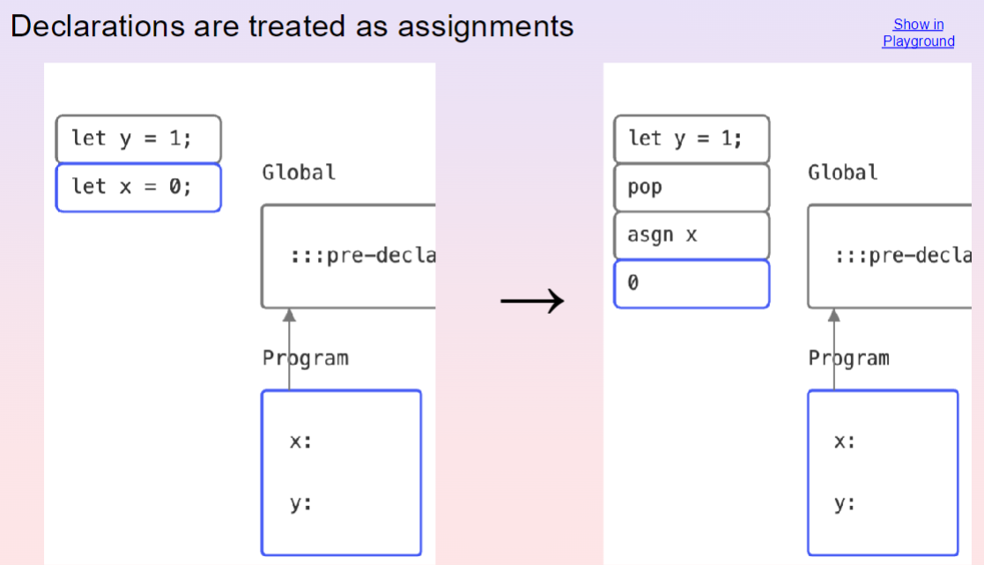
Declarations

Slide 16
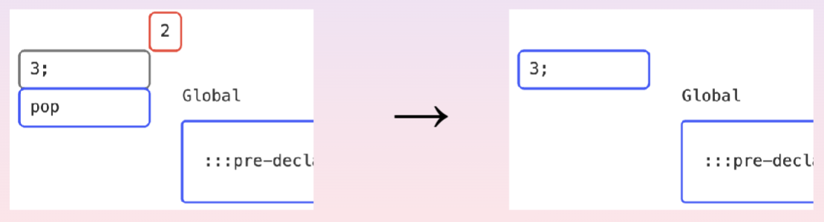
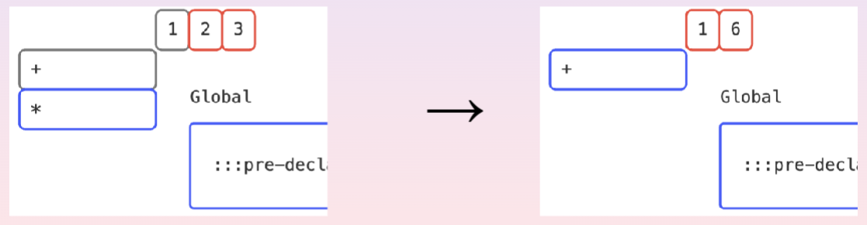
Instructions
pop: Remove next item from stash
Operators (+, -, *, /): Pop operands from stash and push result into stash

Slide 17
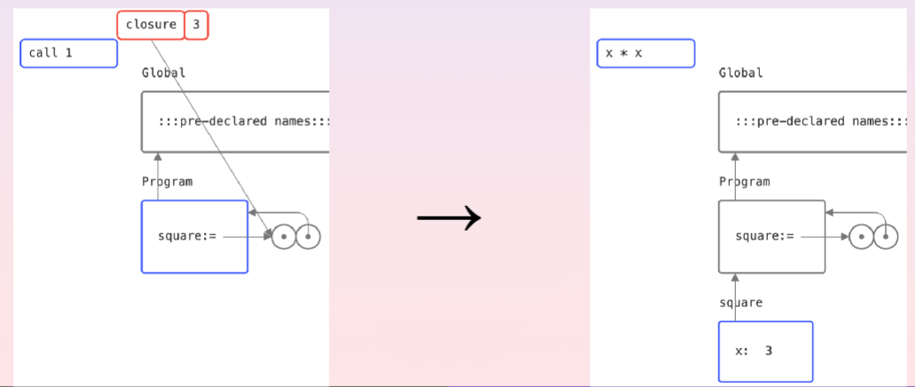
Instructions
call: Pop function and arguments from stash
Place arguments in new frame, extending from function’s environment
Push function body into control

Slide 18
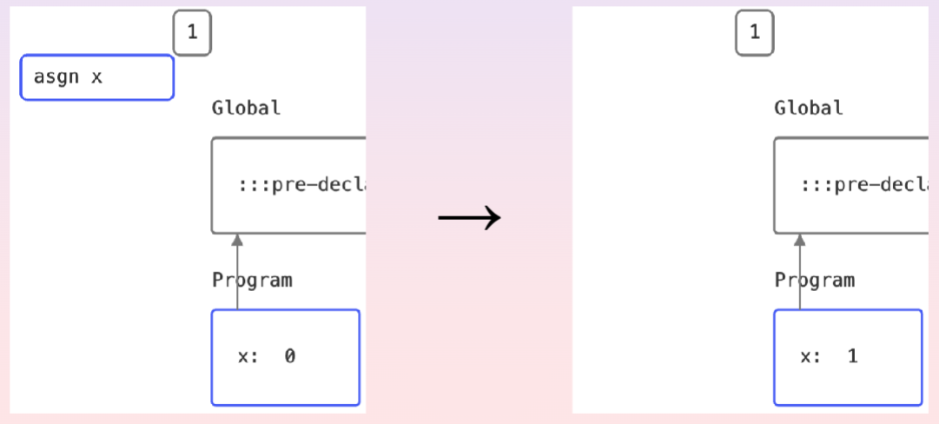
Instructions
asgn: Assign name in current environment to top value of stash

Slide 19
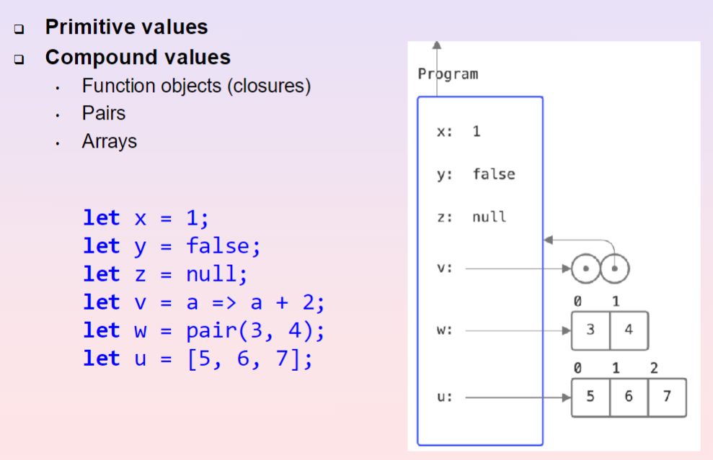
Values in the CSE Machine
Notes:
Primitive Values:
Appear when needed
Placed inside of our stash and frames
Do not carry identity
Compound Values:
Created fresh in environment area
Pointed to from our stash and frames
Carry identity (Recall S9 Sharing & Identity section)

Slide 20
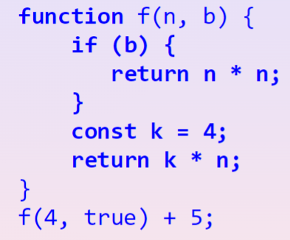
Functions: Returning from everywhere
How do we deal with this?
Notes:
mark instruction

Slide 21
Functions: Returning from everywhere
Special Instruction mark:
Places a “marker” on control, and a return instruction will clear the control until “marker” is reached

Slide 22
Iterative & Recursive Processes
Control accumulates deferred operations if the process is recursive.
Control does not grow if the process is iterative (number of deferred operations does not grow)
I will not discuss about Continuation Passing Style (CPS) since it is not tested.

Slide 23
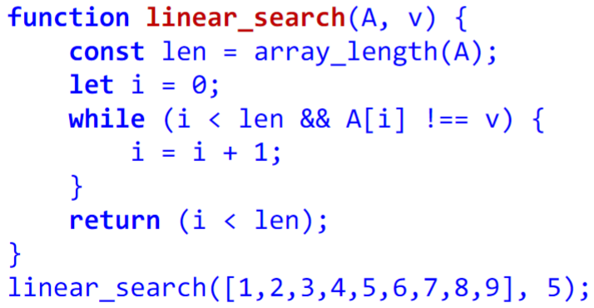
Searching
Goal: Find a number in a given list/array
Input: List/array A and element we want to find v
Output: Return true if element is found, else return false
Linear Search
Inspect the list/array from the front, element by element
If we find it, return true, else continue traversing until end of list.
Remember, arrays are random access, therefore any value can be retrieved in O(1)
Runtime: O(n), where n is the size of array

Slide 24
Searching
Goal: Find a number in a given array
Input: SORTED array, A and element we want to find, v
Output: Return true if element is found, else return false
Binary Search
Check the middle element
If middle element is v, return true
Else, decide if we should search the left or right
This does not work well with lists, why?
Runtime: O(logn), where n is the size of array
We can implement using recursion or a for loop. Try both methods!

Slide 25
Sorting
Goal: To sort a given array
Input: List/array, A
Output: Sorted array, A’
Three sorting algorithms we learn in CS1101S:
Selection Sort
Insertion Sort
Merge Sort

Slide 26
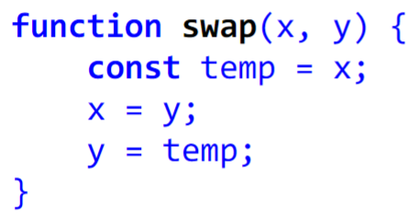
swap function
But first, let’s make a swap function…
Is this correct?

Slide 27
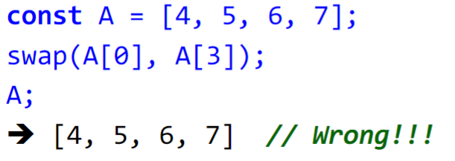
swap function
But first, let’s make a swap function…
Nope…

Slide 28
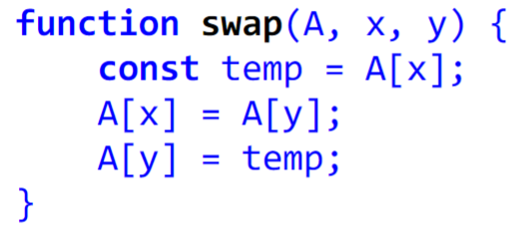
swap function
Correct implementation of swap:

Slide 29
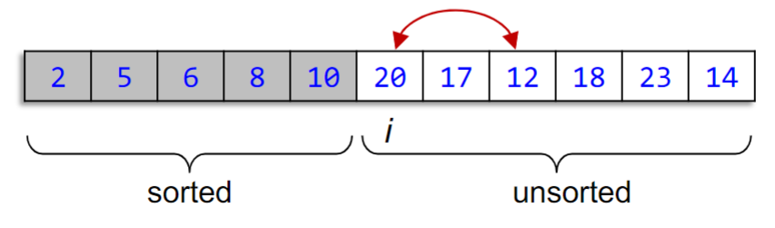
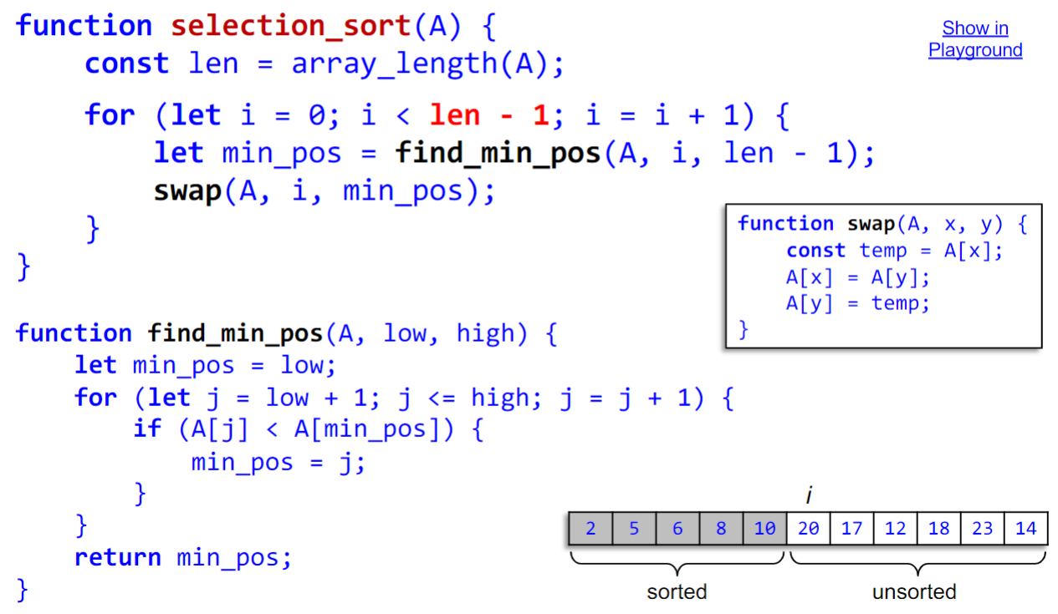
Selection Sort
Idea for Arrays:
Find smallest element, swap with first element
Consider the smaller subarray on the right, repeat.
Runtime: ?

Slide 30
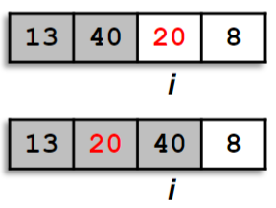
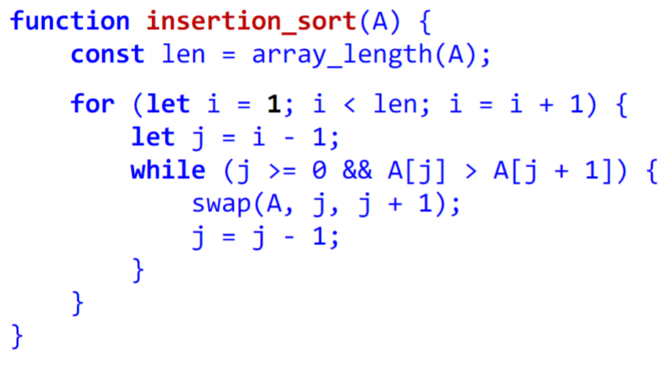
Insertion Sort
Idea for Arrays:
Move pointer i from left to right
Array to the left is sorted
Move the value at i to the correct position of the sorted array
Runtime: ?

Slide 31
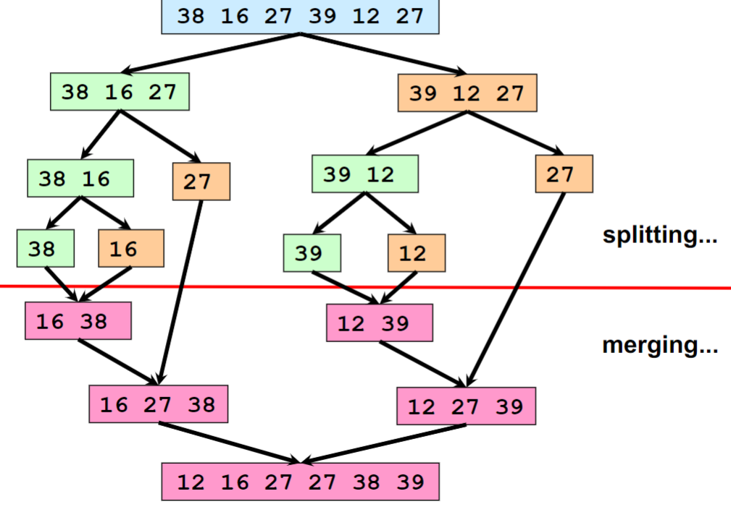
Merge Sort
Idea for Arrays:
Split the array into 2 halves
Sort the 2 halves
Merge the 2 halves
Note: Temporary arrays are used…

Slide 32
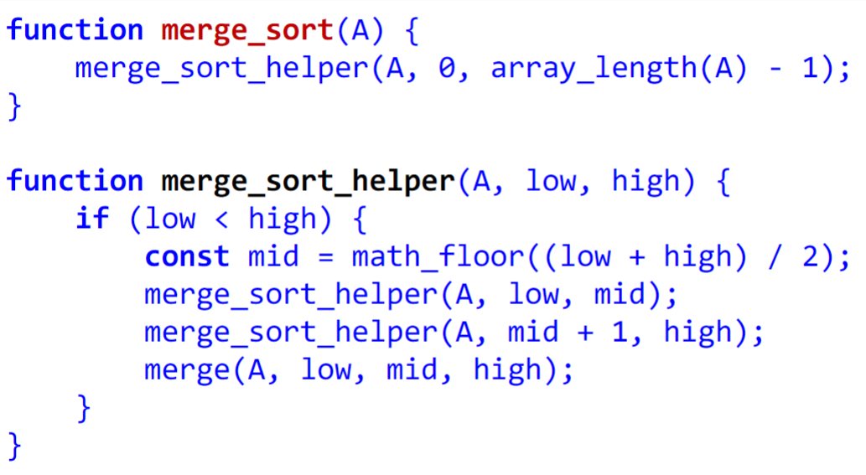
Merge Sort
Notes:
Merge_sort_helper is like our “split” operation

Slide 33
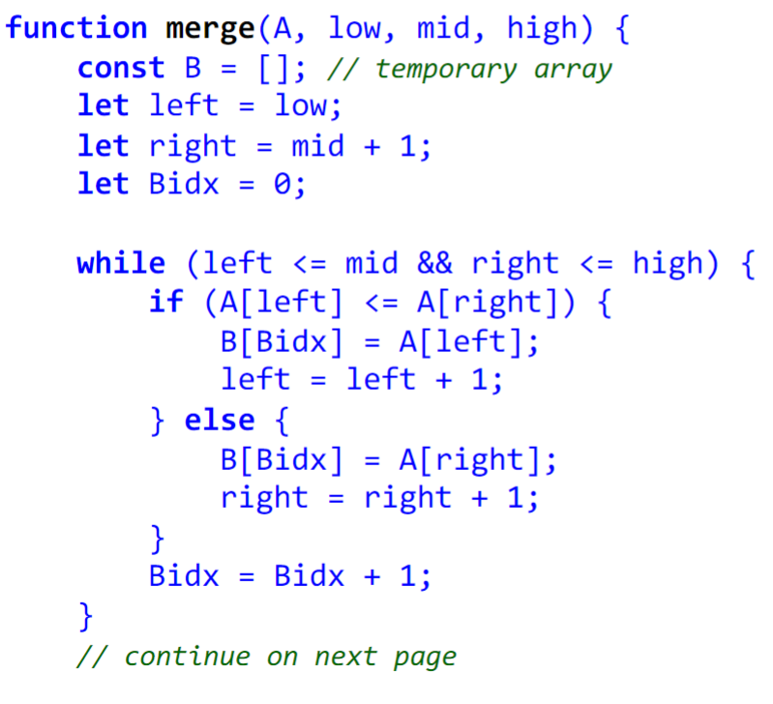
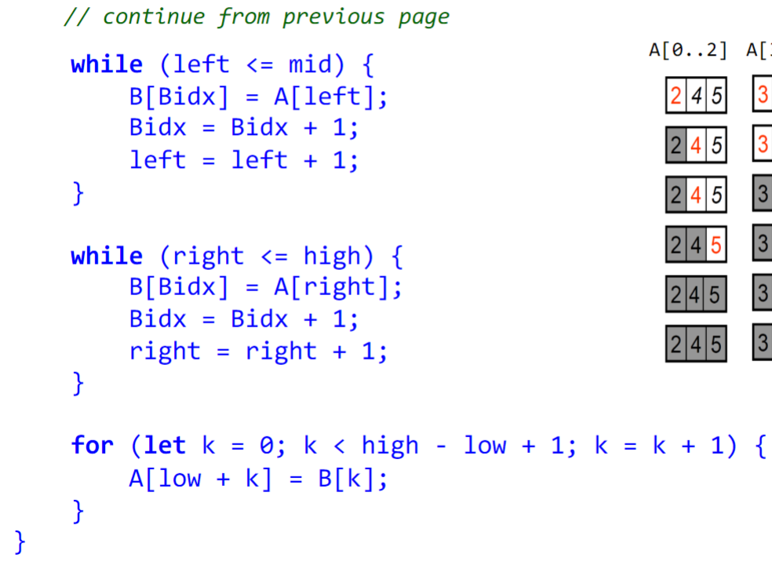
Merge Sort

Slide 34
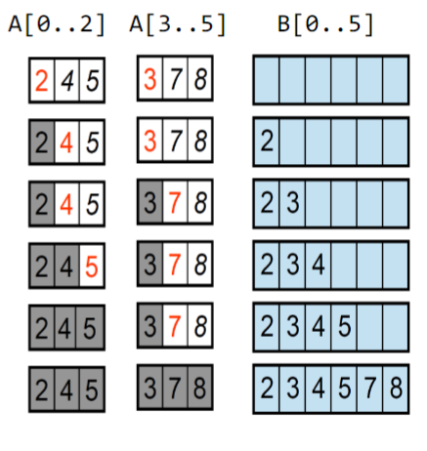
Merge Sort
Runtime: ?

Slide 35
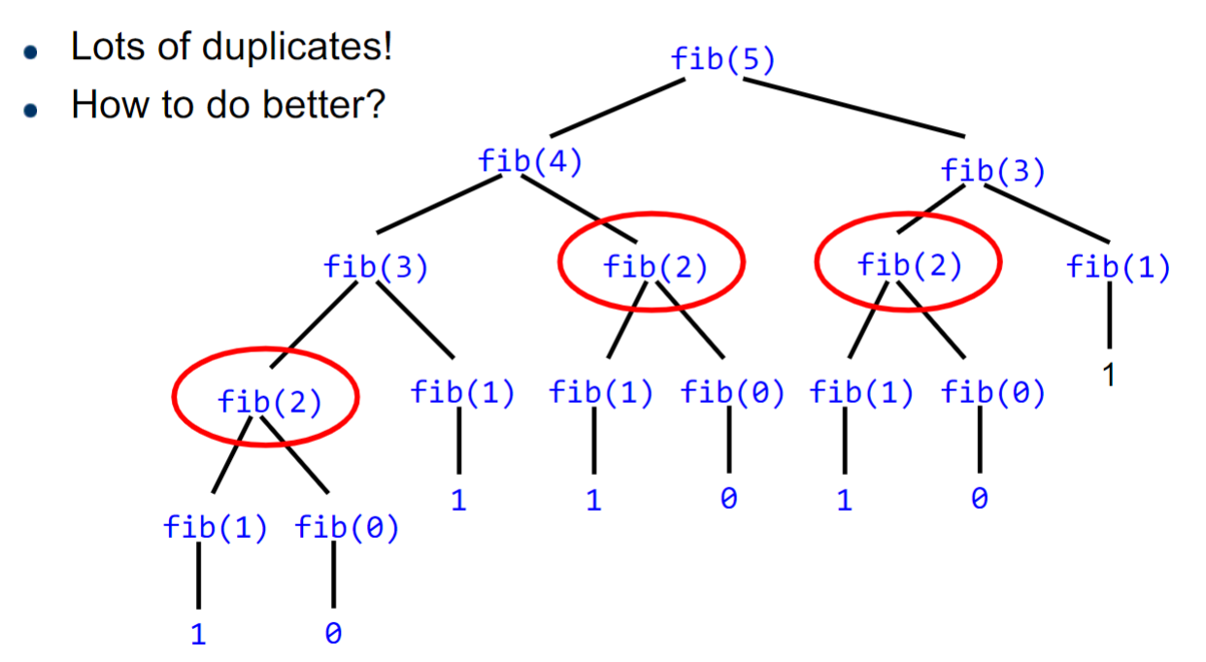
Memoization
Key Idea:
Keep track of calculated values in a local table

Slide 36
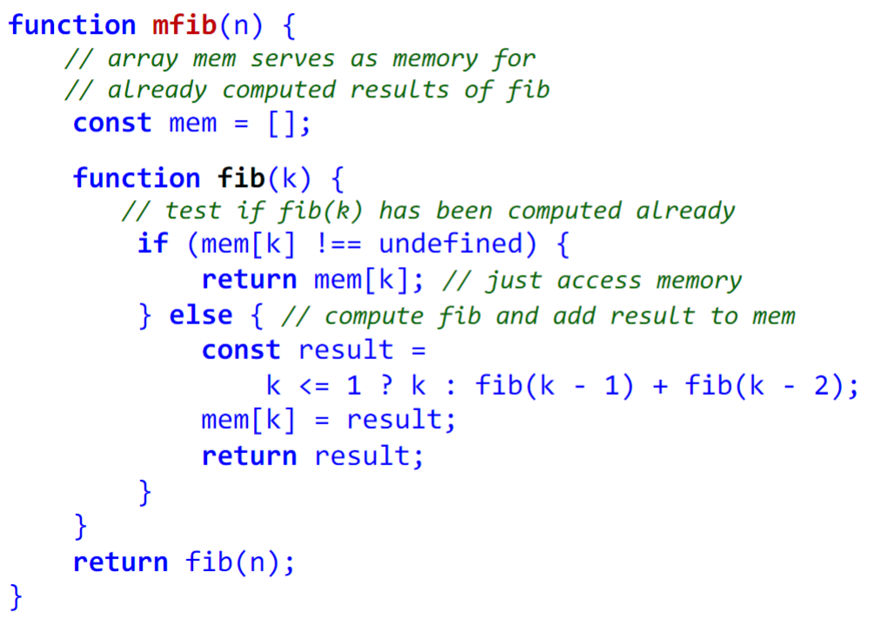
Memoization
Memoized fib:

Slide 37
Memoization
Memoized fib:
Order of Growth: ?

Slide 38
Memoization
Memoized fib:
Order of Growth: O(n)

Slide 39
Memoization
Memoized fib:
Order of Growth: O(n)
Currently, we are using mem as local memory, should we make it global?

Slide 40
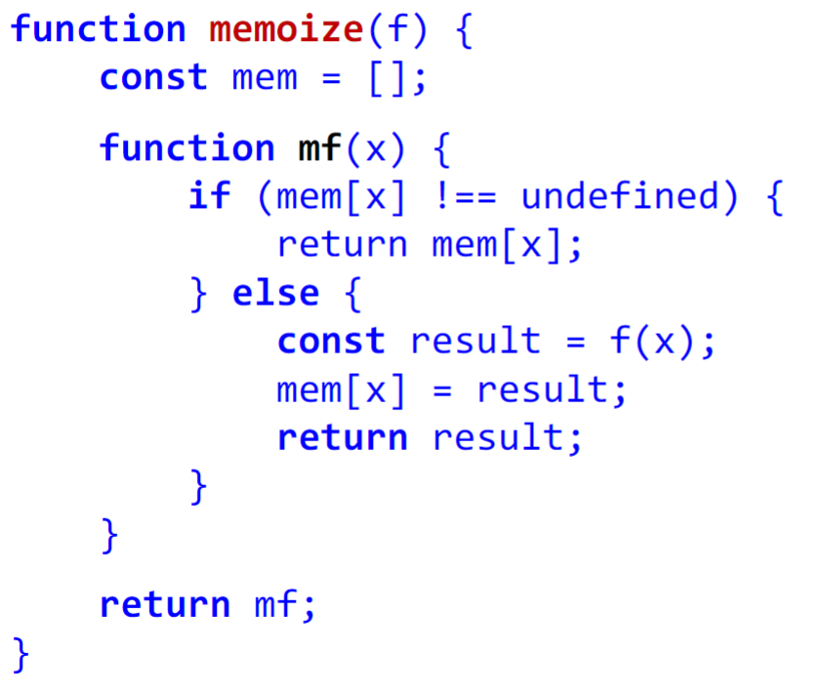
Abstracting Memoization

Slide 41
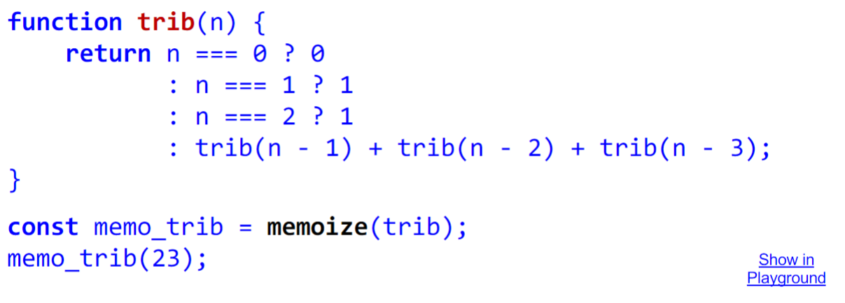
Abstracting Memoization
Order of growth in time: ?

Slide 42
Abstracting Memoization
Order of growth in time: Exponential! Why?
Notes:
Go back to how memoize is implemented and circle out f(x)

Slide 43
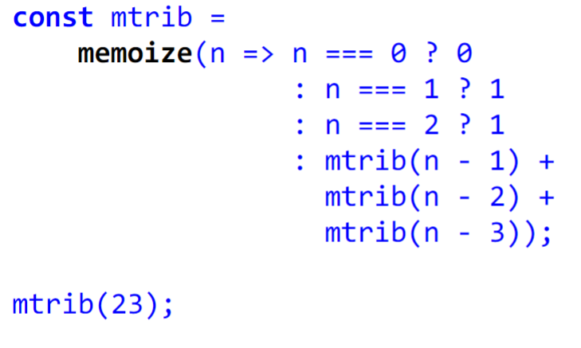
Abstracting Memoization
Order of growth in time: ?
Notes:
Go back to how memoize is implemented and circle out f(x)

Slide 44
Abstracting Memoization
Order of growth in time: O(n)
Notes:
Go back to how memoize is implemented and circle out f(x)

Slide 45
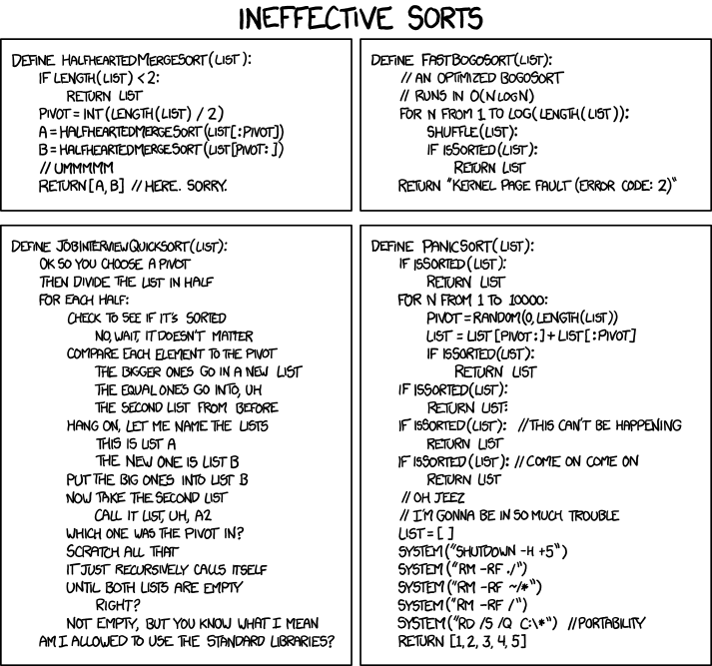
Searching &
Sorting;
Memoization
S10 Studio Sheet & In-class

Slide 46
RA2 Past Year Papers
Why only got Environment Model questions :(

Slide 47
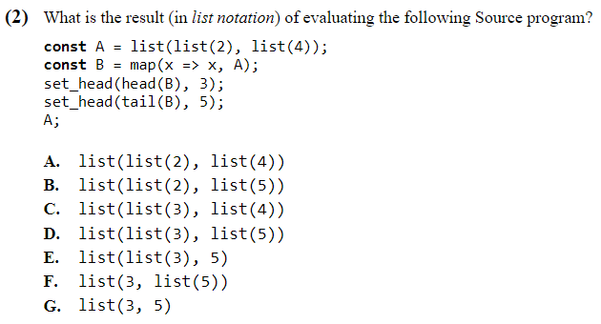
AY20/21 Q2
Notes:
Answer is C

Slide 48
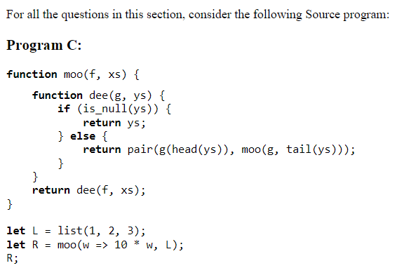
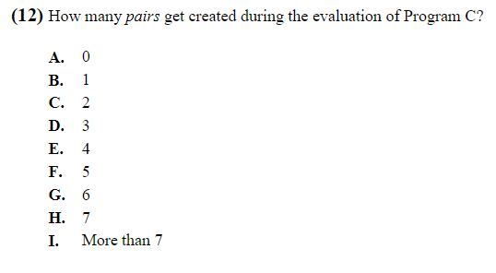
AY21/22 Section C
Notes:
Answer is G

Slide 49
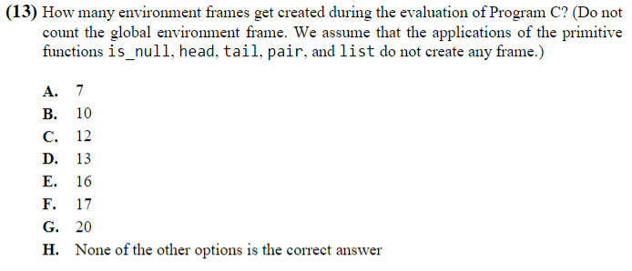
AY21/22 Section C
Notes:
Answer is E

Slide 50
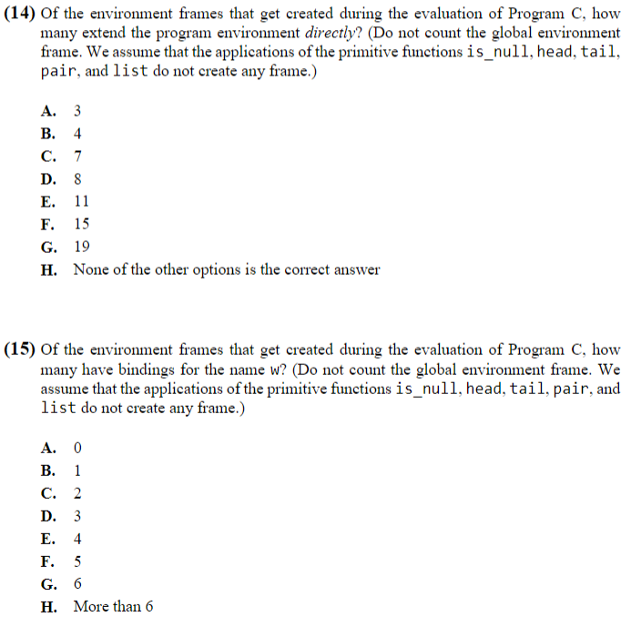
AY21/22 Section C
Notes:
Answer is C & D

Slide 51
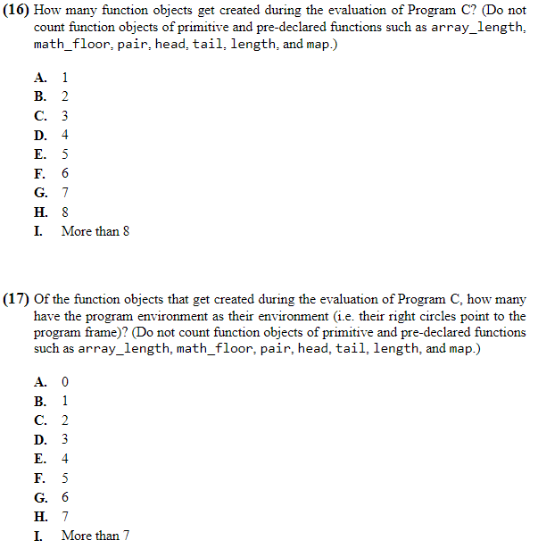
AY21/22 Section C
Notes:
Answer is F & C

Slide 52
See you next week!
Slides will be uploaded to the google drive.

